Slide 1
SmartBooking
By Team#08
Poonam Johl-A20390497
Ahmed Sayed-A20388365
Shubham Bhardwaj- A20379553
Akshatha Kadri-A20387491
Meghana Subbanna-A20381262

Slide 2
Introduction
A user friendly website that helps to choose hotels at great price , packages.
Online portal to help users to book hotels.
We have filters by brand, budget and amenities.
The customer can find hotels by locations.

Slide 3
Functionalities
Customer can register, create profile and add payment details
Will be able to book, cancel and modify(pre-pone, post-pone), check-in, check-out.
There will be options to choose room type, amenities offered, cost ranges.
Hotel selection from different categories.
Option to Read and Write reviews.

Slide 4
Admin Interface
Admin will be able to add, remove and update products(Hotels).
Ability to add , remove and update customers information.
Add offers and packages.
Promotion coupons for valued customer.

Slide 5
Technology used
Servlets
JSP
Mysql
MongoDb
Javascript
Jquery
Ajax
Boostrap

Slide 6
Use case Diagram

Slide 7
Class Diagram

Slide 8
Extra feature
WishList
Send Automated notifications to customers a day before the check-in.
Suggestions
Coupons

Slide 9
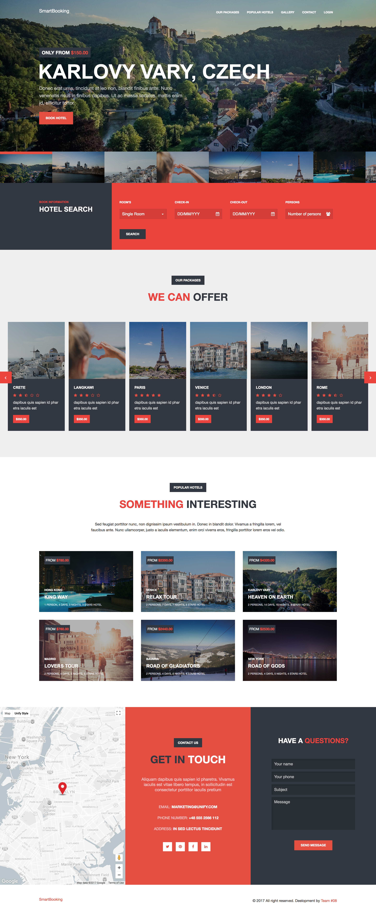

Slide 10
Questions?

